Slide 1
K-Means Clustering
Unsupervised ML algorithm

Slide 2
Introduction
K-means clustering, a part of the unsupervised learning family in AI, is used to group similar data points together in a process known as clustering.
Clustering helps us understand our data in a unique way – by grouping things together into – you guessed it – clusters.

Slide 3
What is Clustering?
Cluster analysis is a technique used in data mining and machine learning to group similar objects into clusters.
K-means clustering is a widely used method for cluster analysis where the aim is to partition a set of objects into K clusters in such a way that the sum of the squared distances between the objects and their assigned cluster mean is minimized.

Slide 4
Hierarchical clustering and k-means
Hierarchical clustering and k-means clustering are two popular techniques in the field of unsupervised learning used for clustering data points into distinct groups.
While k-means clustering divides data into a predefined number of clusters,
hierarchical clustering creates a hierarchical tree-like structure to represent the relationships between the clusters.

Slide 5
Example
Let’s try understanding this with a simple example. A bank wants to give credit card offers to its customers. Currently, they look at the details of each customer and, based on this information, decide which offer should be given to which customer.
Now, the bank can potentially have millions of customers. Does it make sense to look at the details of each customer separately and then make a decision?
Certainly not! It is a manual process and will take a huge amount of time.
So what can the bank do? One option is to segment its customers into different groups. For instance, the bank can group the customers based on their income:

Slide 6
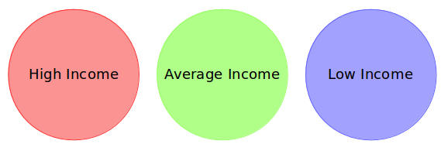
The groups I have shown below are known as clusters, and the process of creating these groups is
known as clustering
Can you see where I’m going with this? The bank can now make three different strategies or offers,
one for each group. Here, instead of creating different strategies for individual customers, they only have to
make 3 strategies. This will reduce the effort as well as the time.

Slide 7
Clustering is the process of dividing the entire data into groups (also known as clusters) based on the patterns in the data.
In clustering, we do not have a target to predict. We look at the data, try to club similar observations, and form different groups. Hence it is an unsupervised learning problem.

Slide 8
Properties of Clusters

Slide 9
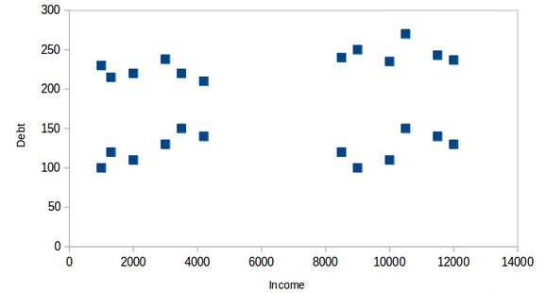
let’s say the bank only wants to use the income and debt to make the segmentation. They collected the customer data and used a scatter plot to visualize it:

Slide 10
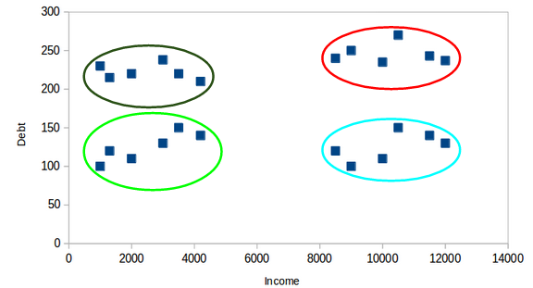
Segments
On the X-axis, we have the income of the customer, and the y-axis represents the amount of debt. Here, we can clearly visualize that these customers can be segmented into 4 different clusters, as shown below:

Slide 11

All the data points in a cluster should be similar to each other.
If the customers in a particular cluster are not similar to each other, then their requirements might vary, right? If the bank gives them the same offer, they might not like it, and their interest in the bank might reduce. Not ideal.

Slide 12
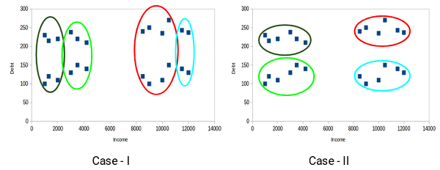
The data points from different clusters should be as different as possible.

Slide 13
Applications of Clustering in Real-World Scenarios
Customer Segmentation
Document Clustering
Image Segmentation
Recommendation Engines

Slide 14
Inertia
This is what inertia evaluates. It tells us how far the points within a cluster are. So, inertia actually calculates the sum of distances of all the points within a cluster from the centroid of that cluster.
Normally, we use Euclidean distance as the distance metric, as long as most of the features are numeric; otherwise, Manhattan distance in case most of the features are categorical.
We calculate this for all the clusters; the final inertial value is the sum of all these distances. This distance within the clusters is known as intracluster distance. So, inertia gives us the sum of intracluster distances:

Slide 15
Dunn Index
We now know that inertia tries to minimize the intracluster distance. It is trying to make more compact clusters.
Let me put it this way – if the distance between the centroid of a cluster and the points in that cluster is small, it means that the points are closer to each other. So, inertia makes sure that the first property of clusters is satisfied. But it does not care about the second property – that different clusters should be as different from each other as possible.

Slide 16
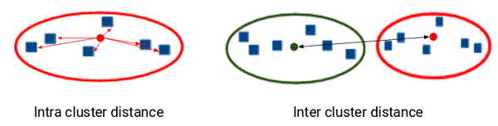


Slide 17
Silhouette Score
The silhouette score and plot are used to evaluate the quality of a clustering solution produced by the k-means algorithm.
The silhouette score measures the similarity of each point to its own cluster compared to other clusters, and the silhouette plot visualizes these scores for each sample.
A high silhouette score indicates that the clusters are well separated, and each sample is more similar to the samples in its own cluster than to samples in other clusters.
A silhouette score close to 0 suggests overlapping clusters, and a negative score suggests poor clustering solutions.

Slide 18
The K-Means Clustering
Recall the first property of clusters — it states that the points within a cluster should be similar to each other. So, our aim here is to minimize the distance between the points within a cluster.
There is an algorithm that tries to minimize the distance of the points in a cluster with their centroid — the k-means clustering technique.
The main objective of the K-Means algorithm is to minimize the sum of distances between the points and their respective cluster centroid.

Slide 19
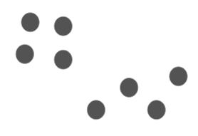
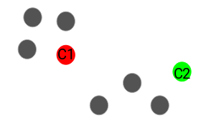
Step -1 Choose the number of clusters k The first step in k-means is to pick the number of clusters, k.
Step 2: Select k random points from the data as centroids Next, we randomly select the centroid for each cluster. Let’s say we want to have 2 clusters, so k is equal to 2 here. We then randomly select the centroid:

Slide 20
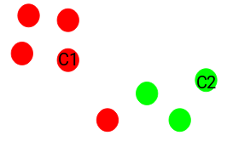
Step 3: Assign all the points to the closest cluster centroid Once we have initialized the centroids, we assign each point to the closest cluster centroid:

Slide 21
E-step ((Expectation-step))
The E-step is responsible for updating the cluster assignments of the data points. It involves assigning each data point xi to the nearest centroid, μk, using a chosen distance metric. This step is represented by the minimization of the objective function J with respect to wik:
minJ(wik) = ∑k=1^K ∑i=1^n wik ||xi - μk||^2
where:
wik is an indicator variable that equals 1 if xi belongs to cluster k, and 0 otherwise
||xi - μk||^2 is the squared distance between xi and μk

Slide 22
It’s a minimization problem of two parts.
We first minimize J w.r.t. wik and treat μk fixed.
Then we minimize J w.r.t. μk and treat wik fixed.
Technically speaking, we differentiate J w.r.t. wik first and update cluster assignments (E-step).
Then we differentiate J w.r.t. μk and recompute the centroids after the cluster assignments from previous step (M-step).
Therefore, E-step is:

Slide 23
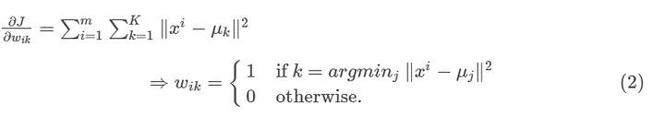
In other words, assign the data point xi to the closest cluster judged by its sum of squared distance
from cluster’s centroid.

Slide 24
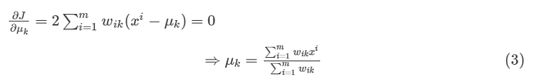
And M-step is:
Which translates to recomputing the centroid of each cluster to reflect the new assignments.

Slide 25
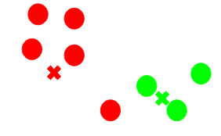
Step 4:Recomputed the centroids of newly formed clusters Now, once we have assigned all of the points to either cluster, the next step is to compute the centroids of newly formed clusters:
Here, the red and green crosses are the new centroids.
Computation of the centroids for the clusters is done by taking the MEAN of the all data points that belong to each cluster:
There is another Algorithm K-Medioids which does the same thing but in this step it takes the MEDIAN

Slide 26
popularly used similarity measures are
KMeans generally uses the Euclidean Distance (also known as the squared distance), the most common distance used in Euclidean or Cartesian Geometry. But one can choose any distance or form of similarity for this purpose.

Slide 27

Cosine distance
Cosine distance: It determines the cosine of the angle between the point vectors of the two points in the n dimensional space.

Slide 28

Manhattan distance:
It computes the sum of the absolute differences between the coordinates of the two data points.

Slide 29

Minkowski distance:
It is also known as the generalized distance metric. It can be used for both ordinal and quantitative variables.

Slide 30
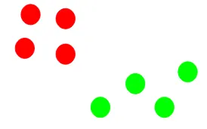
Step 5: Repeat steps 3 and 4

Slide 31
The step of computing the centroid and assigning all the points to the cluster based on their distance from the centroid is a single iteration. But wait – when should we stop this process? It can’t run till eternity, right?

Slide 32
Stopping Criteria for K-Means Clustering
There are essentially three stopping criteria that can be adopted to stop the K-means algorithm:
Centroids of newly formed clusters do not change
Points remain in the same cluster
Maximum number of iterations is reached

